Slide 1

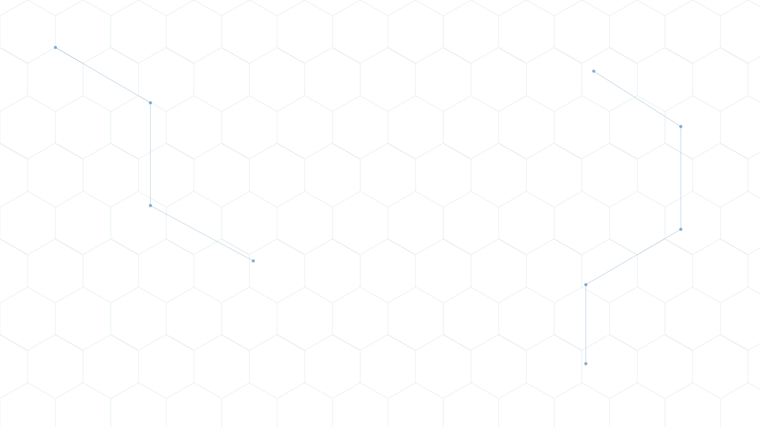
23AID302 — BIG DATA ANALYTICS | 0TH REVIEW
MediSpark
A Scalable Multi-Disease Clinical Risk Prediction Engine
Apache Spark · Hadoop HDFS · Scala · Spark MLlib · Docker
Suman Maitreya | CB.AI.U4AID24156
23AID302 — Big Data Analytics
Supervisor: Dr. Sreeja B P
Amrita Vishwa Vidyapeetham, Coimbatore
MediSpark | 23AID302
01

Slide 2


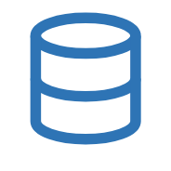


INTRODUCTION
Healthcare Meets Big Data
·The healthcare sector generates millions of patient records daily
Hospital
from hospitals, wearables, labs, and EHRs
·Traditional systems cannot process this volume, velocity, and
variety of data in real time
·Chronic diseases — heart disease, diabetes, stroke, lung cancer
Data
— cause 70%+ of global deaths annually
·Early detection through data-driven prediction can save millions
of lives
·Big Data technologies like Apache Spark and Hadoop HDFS now
Big Data Tools
enable scalable, real-time healthcare analytics
MediSpark | 23AID302
02
Prediction

Slide 3




DOMAIN IMPORTANCE
Why This Domain Matters
Scale
Speed
Complexity
Value
500 million TB of health data
generated daily worldwide
ICU monitors generate
real-time vitals every second
Multi-format data — labs,
images, notes, wearables
Predictive analytics can cut
misdiagnosis by 30%
Source: WHO Global Health Observatory & IDC Data Age 2025 Report
MediSpark | 23AID302
03

Slide 4

THE PROBLEM
Problem Statement
Existing healthcare prediction systems are designed for a single disease,
operate on static datasets, and cannot process the massive volume, velocity,
and variety of modern patient data in real time — leaving hospitals without a
scalable, unified, multi-disease early-warning system.
✗
Single-disease models — no unified multi-disease prediction exists
✗
Batch-only systems — cannot score new patient records in real time
✗
No veracity handling — messy, missing, inconsistent clinical data ignored
MediSpark | 23AID302
04

Slide 5
RELATED WORK
Literature Review — Related Work
Paper | Year | What They Did | Key Gap
Ed-daoudy et al. (Springer) | 2023 | Real-time heart disease prediction using Twitter + Kafka + Spark MLlib | Single disease only. No HDFS. No data quality pipeline.
Ebada et al. | 2022 | Stroke prediction using Spark MLlib batch processing | No streaming. No data variety. Single disease.
Kiran et al. | 2020 | Heart disease streaming prediction with Spark Streaming + MLlib | No HDFS. No ML Pipeline API. No veracity handling.
Ed-daoudy & Maalmi (Springer) | 2019 | IoT + Kafka + Cassandra + Spark for multi-stream disease monitoring | No HDFS. No Scala. Overly complex. No veracity.
All 4 papers address only 1–2 aspects. None provides a complete, unified, reproducible Big Data healthcare pipeline.
MediSpark | 23AID302
05

Slide 6
RESEARCH GAP
Research Gap
What Exists
What MediSpark Provides
✗Single-disease prediction models only
✓4 diseases predicted simultaneously in one pipeline
✗No distributed HDFS-based storage
✓Full HDFS storage with 3× block replication
✗No dedicated data veracity/quality pipeline
✓Dedicated veracity pipeline — IQR, null handling, dedup
✗Streaming OR batch — never both together
✓Both batch training AND real-time Structured Streaming
✗Complex infrastructure (Kafka, Cassandra) not reproducible
✓Simple Docker-based setup — fully reproducible
✗No Scala-based unified ML Pipeline API implementation
✓Scala Spark ML Pipeline API — production-grade architecture
MediSpark | 23AID302
06

Slide 7

ARCHITECTURE
Proposed System — MediSpark Pipeline
Datasets
(Kaggle/UCI)
HDFS Storage (3
DataNodes)
Spark Data
Cleaning (Scala)
Feature Engineering
Spark MLlib
Training (RF + LR)
Structured
Streaming
Risk Score Output
•
Processes 4 diseases — Heart, Diabetes, Stroke, Lung Cancer — in parallel
•
Scores new patients in real time every 5 seconds via Spark Streaming
•
Outputs: Patient ID | Disease | Risk Level (High/Medium/Low) | Confidence %
MediSpark | 23AID302
07

Slide 8
COMPARISON
How MediSpark Improves Over Existing Work
Existing Systems | MediSpark
1 disease predicted | 4 diseases simultaneously
Python on single machine | Scala on distributed Spark cluster
Local CSV storage | HDFS with 3× replication
No streaming | Spark Structured Streaming — live scoring
Drop nulls only | Full veracity pipeline — IQR, dedup, validation
Individual models | Spark ML Pipeline API — modular, reusable
Complex infra (Kafka, Cassandra) | Simple Docker Compose — reproducible
MediSpark | 23AID302
08

Slide 9




CONTRIBUTION
What is New in MediSpark
Multi-Disease Parallelism
Real-Time Streaming Layer
One unified Spark pipeline predicts 4 chronic diseases
simultaneously. No existing student project or paper
does this in a single framework.
Spark Structured Streaming scores new patient
records every 5 seconds. Batch + Streaming in the
same pipeline.
Veracity-First Design
Production-Grade Scala ML Pipeline
Dedicated data quality stage: IQR outlier removal, null
imputation, duplicate detection, schema validation +
quality report to HDFS.
Built with Spark ML Pipeline API in Scala — the same
architecture used at Netflix, Uber, LinkedIn — not just a
notebook experiment.
MediSpark | 23AID302
09

Slide 10
OBJECTIVES
Objectives of the Project
1
To design a distributed data storage and ingestion pipeline using Hadoop HDFS and Docker.
2
To implement a data quality and veracity pipeline in Scala for cleaning and validating multi-format healthcare data.
3
To engineer feature transformation pipelines using Spark DataFrames and the ML Pipeline API.
4
To train and evaluate multi-disease risk prediction models using Spark MLlib (Random Forest + Logistic Regression).
5
To implement real-time patient risk scoring using Spark Structured Streaming.
6
To evaluate model performance using AUC-ROC, Precision, Recall, and F1-Score metrics stored in HDFS.
MediSpark | 23AID302
10

Slide 11
TECHNICAL STACK
Tools, Technologies & Datasets
Tools & Technologies
Datasets
Tool | Purpose
Apache Spark 3.5 | Distributed data processing & ML
Hadoop HDFS | Distributed fault-tolerant storage
Scala | Primary pipeline implementation language
Spark MLlib | Model training — RF & Logistic Regression
Spark ML Pipeline API | Modular feature + model pipelines
Spark Structured Streaming | Real-time patient risk scoring
Docker & Docker Compose | Reproducible multi-node cluster setup
Jupyter / Zeppelin | Exploratory data analysis & visualization
Dataset | Size | Source
Heart Disease UCI | 303 records | UCI ML Repository
Pima Indians Diabetes | 768 records | Kaggle
Stroke Prediction Dataset | 5,110 records | Kaggle
Lung Cancer Dataset | 1,000 records | Kaggle
Synthetic Streaming Feed | Generated | Custom Scala generator
MediSpark | 23AID302
11

